Slide 1
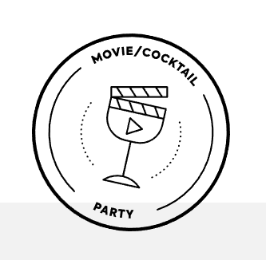
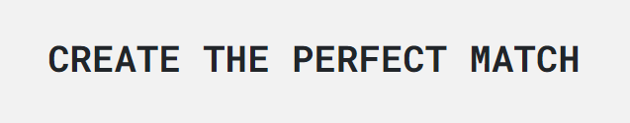
MovieSlashCocktailParty
“The Lost”
Amelia Bramwell,
Benjamin Cottrell,
Haris Haider,
Rebecca Wood.
Notes:
Hi, Good afternoon,
We’re “The Lost”, I’m Benjamin Cottrell,
Amelia Bramwell
Haris Haider
Rebecca Wood
And this is MovieSlashCocktailParty

Slide 2
What and Why?
Identified a market need
Failures within traditional movie selection,
Awful mixologists.
It was a problem we knew we could solve.
How will we meet the need?
Use multiple APIs,
Client-side storage,
Bootstrap and modals,
User Input and response.
Notes:
As a group we were able to identify a desperate need in the market.
People were systematically failing to choose the correct movie to be shown at their parties,
and even more concerning,
they didn’t know which cocktail would enhance the experience.
Our goals were simple,
To use both a cocktail and movie API to enhance party planning
To use client side storage to allow users to save cocktail recipes they like,
To use bootstrap and modals to show a modern, well organised website
And most importantly, we wanted user input to dictate the response.
Rebecca will now take us through the conception of the site,

Slide 3

What and Why?
Concept
What does our site do?
What was our motivation?
What is our user story?
Notes:
Our site enables the user to pair a randomised movie & cocktail for their pleasure! The user is also able to save the recipe of the cocktail for future reference.
Our sites concept was inspired by an unnamed TA who wanted help planning valentines day. We took that idea and expanded it to cover all movie and cocktail events
Our user story is
As a movie / cocktail enthusiast…
I WANT to be provided with a random movie/cocktail combination,
SO THAT I can impress, be refreshed and entertained

Slide 4
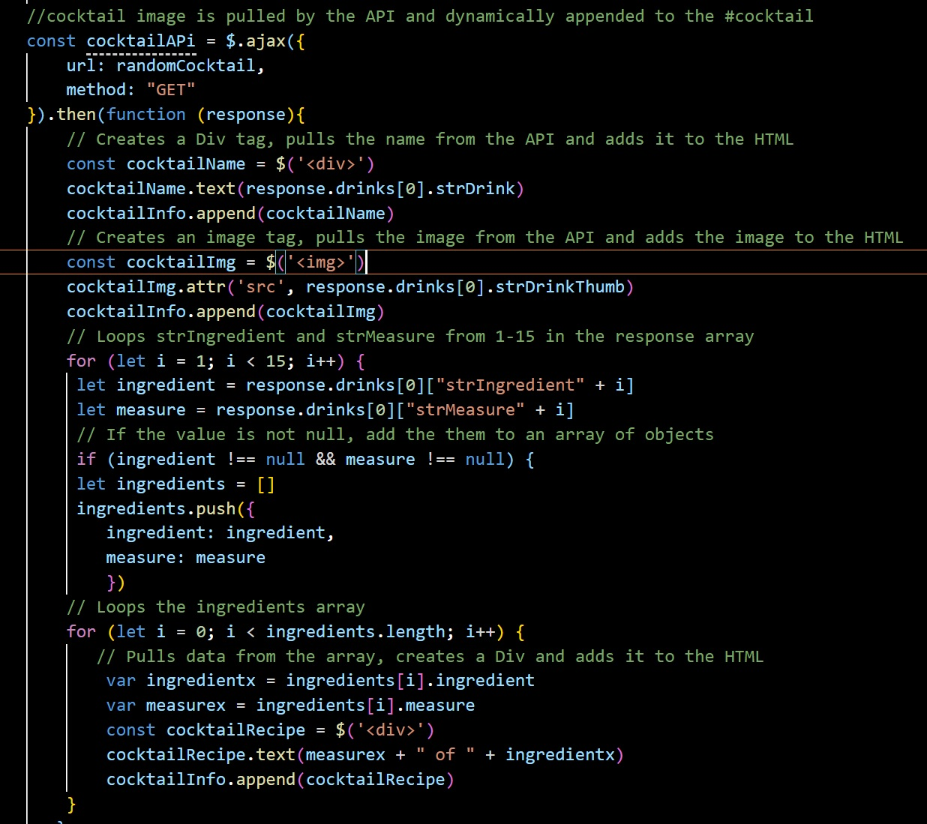
Process
Technologies Used
Github
Agile Workflow
Visual Studio Code
JavaScript
HTML
CSS
Bootstrap
Notes:
How did we do that?
We used multiple technologies to achieve our goal.
The most notable are listed on screen.
Github enabled us to collaborate with our team and provided a source of version control.
We employed an Agile Workflow to ensure that all members of the team were able to be productive and to minimise downtime.
Visual studio code was the platform we used to write the web app.
We used 3 primary coding languages, these were
Javascript - including the Jquery library
HTML
CSS including Bootstrap
Amelia will now explain how we delegated, what are successes were, and where we struggled

Slide 5
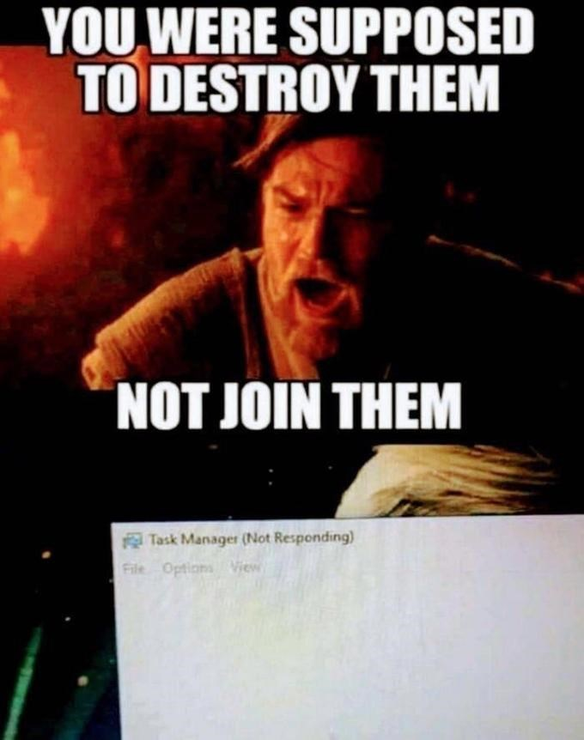
Tasks & Delegation
Tasks & Roles
Amelia – CSS & Bootstrap
Benjamin – JavaScript & Presentation
Haris – HTML, Bootstrap & Demo
Rebecca – JavaScript & Local Storage
Notes:
We worked well as a group and the majority of the work was completed as partner or group coding, whether in or out of class time.
We came together and democratically made decisions, and brainstormed solutions to any problems which arose.
However, we did have individual responsibilities, and they were as follows;
I was responsible for the overall styling and design of the site, this included writing the CSS, linking it to the HTML and ensuring the JavaScript presented as expected.
Benjamin kept us on track and managed the workflow. He wrote the core JavaScript, including setting up the APIs and the functions which did not include Local Storage.
Harris wrote the HTML for both pages, and structured it ready for CSS with bootstrap. He was also responsible for the demo, which you will see shortly.
Rebecca worked on the JavaScript, with a focus on the Local Storage. This included all functions which dynamically created elements for both pages.

Slide 6
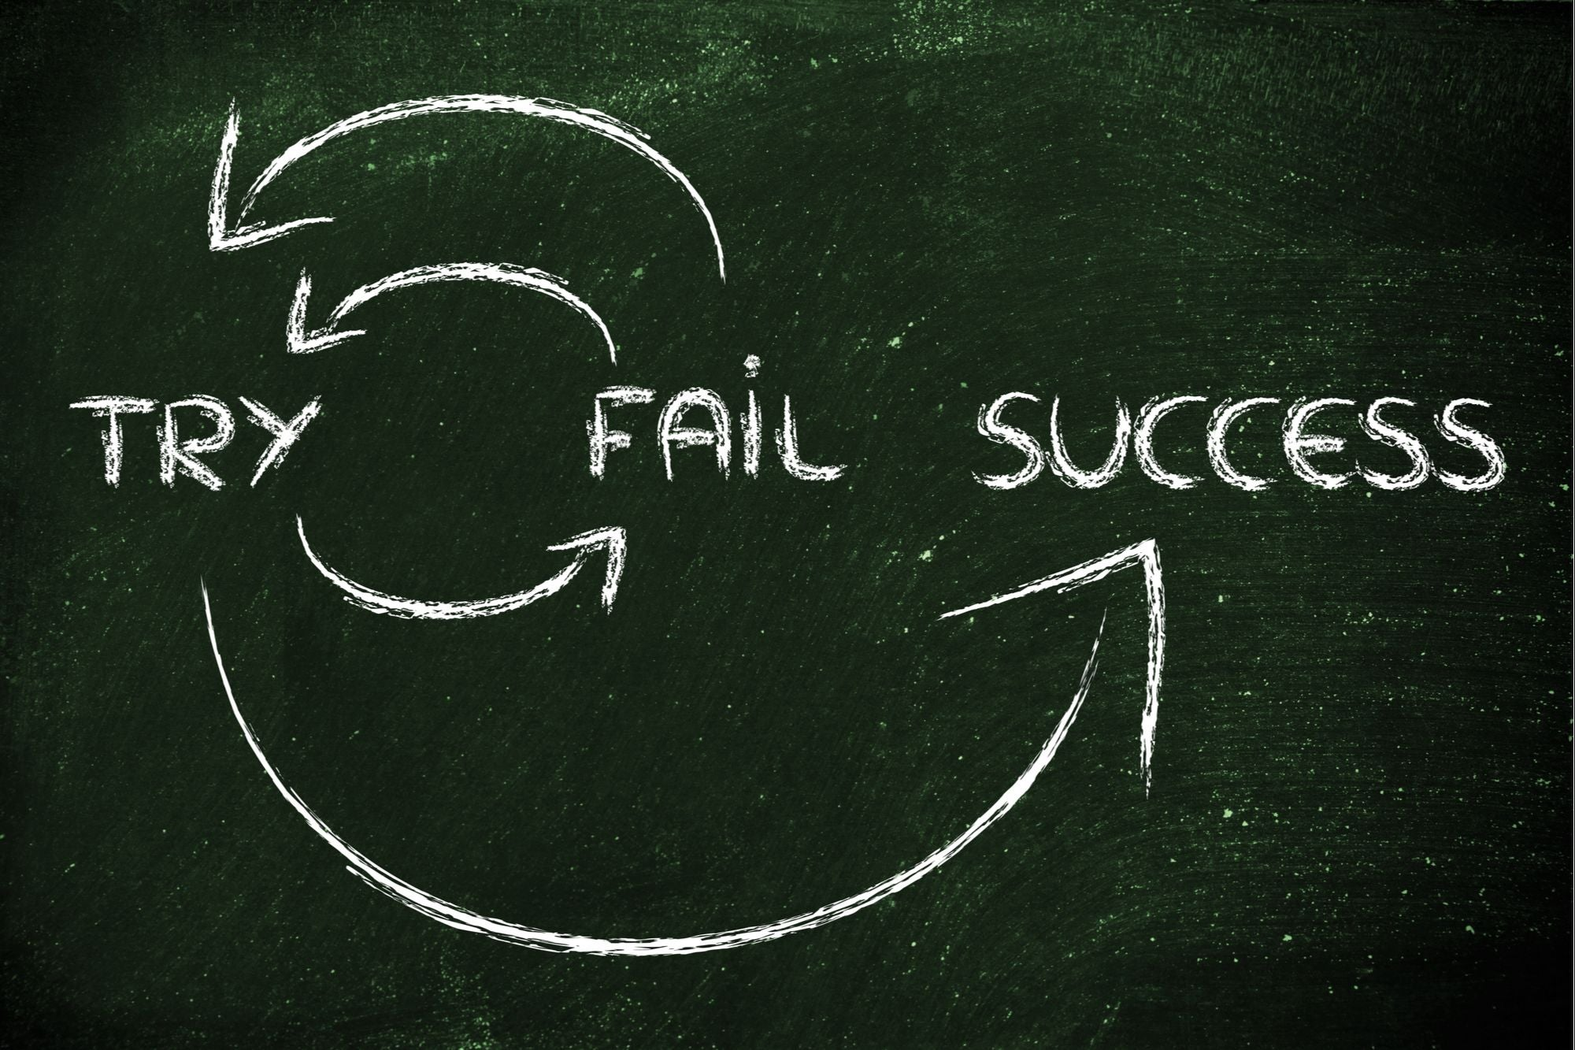
Successes
Successes
Identified individual skill sets,
Effectively distributed work load,
Stayed ahead of schedule to ensure time for styling,
Used tutors to assist with local storage,
Incrementally improved user experience.
Notes:
We had many successes during this project.
We were able to:
- Identify individual skill sets,
- Effectively distribute work load,
- We stayed ahead of schedule to ensure we were able to debug issues,
- We used the resources available to assist with issues, including tutor assistance,
- We worked as a team to incrementally improve the user experience

Slide 7
Challenges
Challenges
Understanding how best to implement local storage,
Working out how to link each element for the best possible user experience,
How to best use GitHub with collaborators,
How to best display elements (grid vs display flex),
Understanding each others coding style.
Notes:
That success came from multiple challenges,
These include, but are not limited to:
Understanding how best to implement local storage,
Working out how to link each element for the best possible user experience,
How to best use Github, including branches and the project board,
How to best employ CSS to display the elements,
And understanding each others coding style
We will now play the demo, and then Harris will take you through future developments.

Slide 8
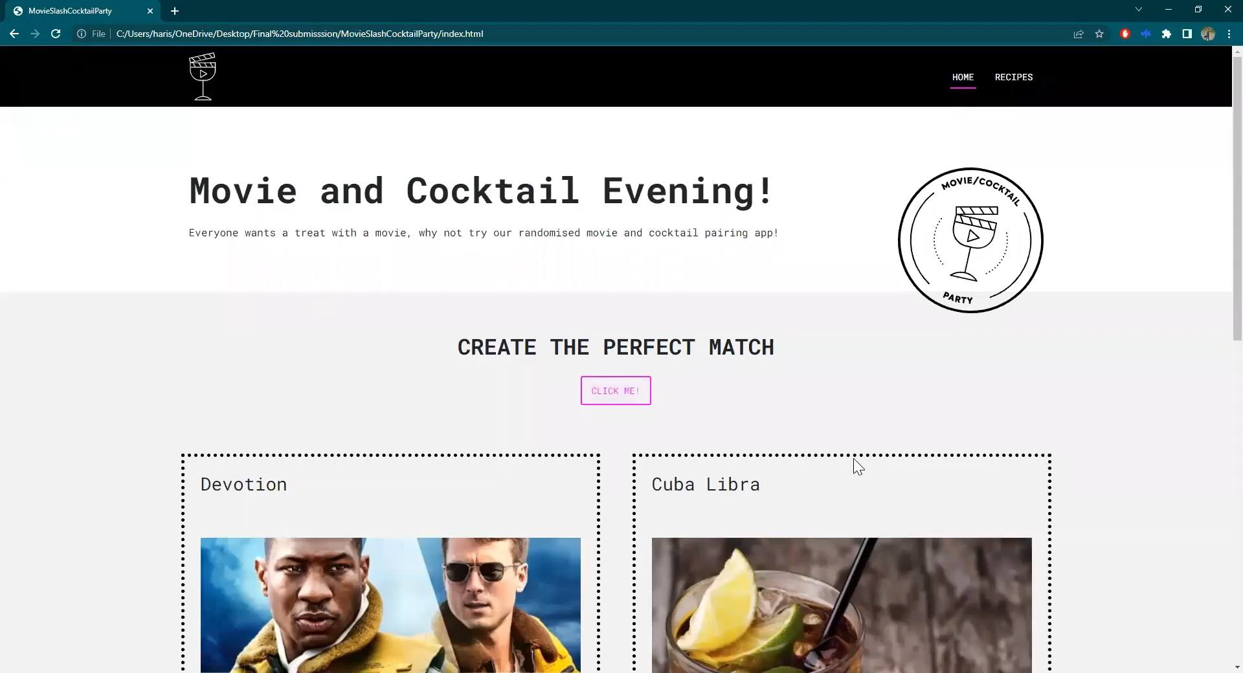
Demo

Slide 9
Future Development
API Changes
Movie saved via Local Storage
Add search functionality
Add a popular tab
Monetisation
Forum/Comment capabilites
Notes:
•Create our own API’s, as we are currently reliant on third-party software..
•Save the movie alongside the cocktail recipe to show previous matches.
•Add search functionality for individual movies and cocktails, for a more rounded user experience.
•Add a popular tab showing the most saved recipes from all users.
•Monetise the site by adding links to where the user can purchase the movie.
•Add a forum where people can discuss their favourite movie/cocktail combinations.

Slide 10
Links & Credits
Links
Deployed URL
https://resonantdevotion.github.io/MovieSlashCocktailParty/
Github Repo
https://github.com/ResonantDevotion/MovieSlashCocktailParty
Credits
w3schools
Cityofaustin: Protected Branches
Coding Bootcamp: API Resources
Learn enough git to be dangerous.
A Basic Git Workflow for Small Projects

Slide 11
MovieSlashCocktailParty
Any Questions?

